Slide 1
2013 Washington Navy Yard Shooting
PAPA 5354: Policy Systems Management Homeland Security, Response & Recovery
Joshua Slaughenhoupt

Slide 2
Due to the sensitive nature of this content, at any point in the presentation you need a break or wish to step out, you are invited to do so.

Slide 3
Thesis Statement
Does an all-hazard response adequately address Active Shooter Threats?
Notes:
Thesis Statement
The 2013 Washington Navy Yard (WNY) active shooter incident is representative of the accelerating occurrence for active shooter incidents annually in the United States (U.S.) and the critical performance gaps that exist in even the most effective responses. The complex and dynamic nature of active shooter incidents impose an acute threat shared among our key critical infrastructure and federal facilities, warranting the most effective practices to address these dangers. A critical analysis for the WNY event will reveal key discrepancies between the Installation’s response for this incident, in comparison to the guidelines recommended through the Navy Installation Emergency Management protocol referred as OPNAVINST 3440.17, for addressing all-hazard emergency responses.
Comparable to the 2013 WNY shooting, these incidents precipitate quickly, often occurring under five minutes or less, meanwhile providing no true profile for the operative, nor any pattern for the selection of victims.

Slide 4
All-Hazard Response
Requires the development of an effective emergency management program to implement key principles, coordinate responsibilities, and establish structure for delivering the core capability to respond to all-hazards emergencies ranging from small-scale local emergencies to large-scale natural disasters and violent criminal activity.
Notes:
National Response Framework Second Edition dated May 2013.
All-hazards
The regulatory basis for the National Incident Management System (NIMS) and National Response Framework (NRF) includes practical response for all-hazard emergencies, ranging from small-scale local emergencies to large-scale natural disasters and violent criminal activity.
Department of Defense (DoD) Installation Emergency Management (IEM) Program
Naval Installation Emergency Management Program, referred as OPNAVINST 3440.17

Slide 5
Active Shooter Threats
1
Prevalence
Notes:
Investigative Assistance for Violent Crimes Act of 2012
“An individual actively engaged in killing or attempting to kill people in a confined and populated area.”
Department of Homeland Security’s (DHS) Interagency Security Committee (ISC)
“An individual or individuals who actively engages in killing or the attempt to kill people in a populated area.”
The use of firearm(s) is implicit for this definition.
This definition forfeits the term “confined” to encompass active shooter incidents that may occur both inside and outside the facility.
Key Federal Government agencies include the White House, U.S. Department of Justice, U.S. Department of Education, and U.S. Department of Homeland Security/Federal Emergency Management Agency respectively.
“Fluid” and “Impressionable”?

Slide 6
Gun Violence
Insider Threat
Acive Shooter Incident
Workplace Violence
Terrorism
Notes:
Reflection Question:
Can you think of any other phrases which is also associated with “Active Shooter Threats”?
E.g. Mass Casualty Incident

Slide 7
Active Shooter Incidents Per Annum, 2000-2016*
Notes:
To seek a better understanding of these threats, the FBI evaluated all active shooter incidents between the years 2000-2013, which included the incident at the WNY in the analysis. Continuum of the studies have included datasets concerning the years 2014-2016, based off the same methodology from the initial study. 2016 is the last available dataset.
*Dataset does not include perpetrators in the analysis.
Reflection Question:
What do you think is the correlation for the accelerating occurrence for between Active Shooter Incidents Post 9/11?

Slide 8
Source: Federal Bureau of Investigation, 2017
Notes:
2010-2016
134 Incidents
907 Casualties
378 Fatalties
Produces an average of 19.4 incidents annually.
For perspective, this correlates to at least one incident less than every three weeks.

Slide 9
Source: Federal Bureau of Investigation, 2017
Notes:
Government Properties 10.5%
23 Incidents total
16 General
7 Military Affiliated
Reflection Question:
Why does Federal Properties experience a relatively low percentage of Active Shooter Incidents in comparison to other venues?
In comparison to other venues, do you consider 10.5% or 23 incidents to be high or low for federal properties?

Slide 10
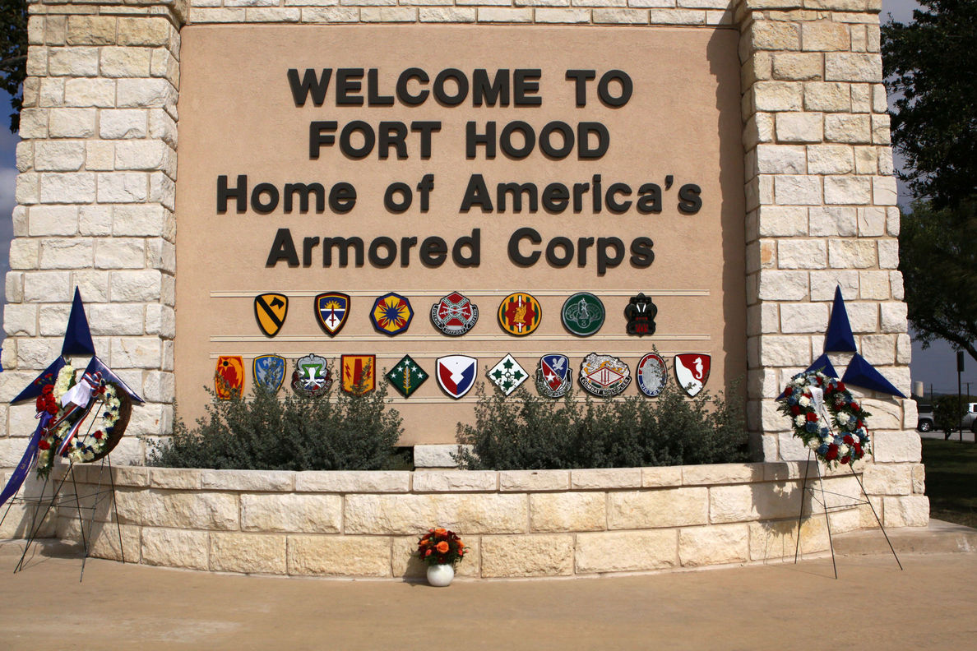
Fort Hood Shooting 2009
Initially challenged the threshold for response within Federal Installations.
Notes:
Occurring on November 5th, 2009, the Fort Hood Shooting resulted in 13 fatalities and 32 additional casualties as a consequence to an active shooter incident within the military installation. Remaining the deadliest shooting to occur on a military base in U.S. history.

Slide 11
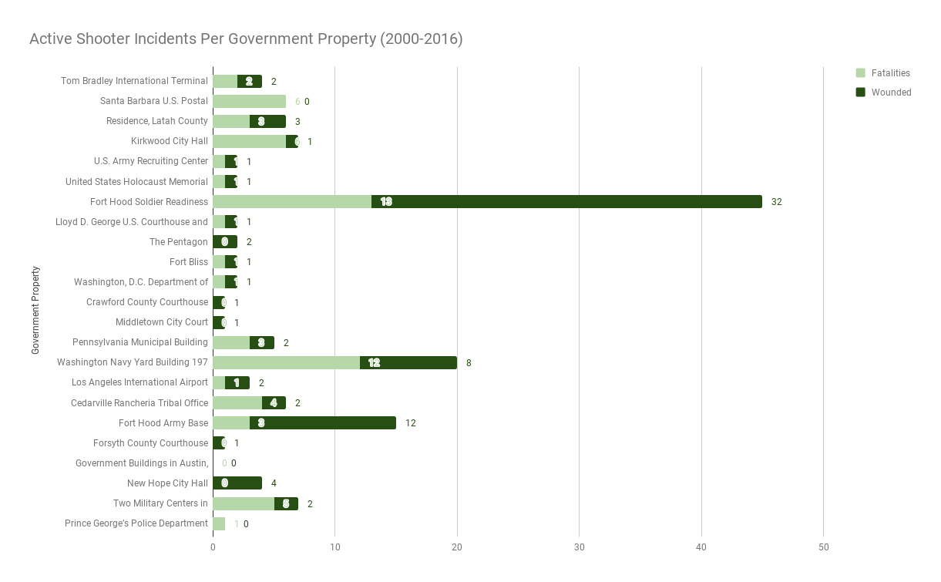
Source: Federal Bureau of Investigation, 2017
Notes:
Incidents are in chronological order.

Slide 12
The Washington Navy Yard
2
Background
Notes:
Established on October 2, 1799.
The oldest Navy installation in the U.S.
Incorporates 68 acres along the bank of the Anacostia River.
Currently serves as the administrative center for the U.S. Navy and home to the Chief of Naval Operations and headquarters of the Naval Sea Systems Command (NAVSEA), as well as several other Navy departments and facilities.
On average, a diverse workforce of more than 17,000 military, civilian and contractor personnel are likely to aboard the WNY daily.

Slide 13
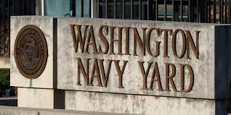
Summary of Events
https://www.youtube.com/watch?v=3w3NSwFcdas
Notes:
On Monday, September 16th, 2013, Aaron Alexis, an independent contractor with Experts, Inc. and former service member with the United States (U.S.) Navy, routinely entered the Washington Navy Yard (WNY) to join a diverse workforce of more than 17,000 military, civilian and contractor personnel. After momentarily entering the Naval Sea Systems Command (NAVSEA), Alexis initiated an active shooter incident that would last approximately 69 minutes before being neutralized. Though over 117 officers from various agencies and departments engaged in incident response, including resources sourced directly from the Naval Support Activity Washington (NSAW), Alexis still fatally shot 12 people and injured eight others through the course of the event.

Slide 14
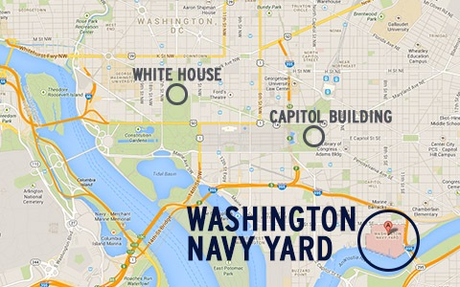

Slide 15
Naval Support Activity Washington (NSAW) & Naval District Washington (NDW)
The Navy Yard installation is patrolled by its own internal police personnel and operates its own emergency services center.
Notes:
In addition, the Navy Yard also includes armed Military Police (MP) personnel, contract security officers (both armed and unarmed), and its own fire department and emergency medical services.
Though the Navy Yard installation shares jurisdiction among Washington’s First Police District of the MPD, it’s not a common practice for MPD officers to regularly patrol the grounds of the installation. Typically, MPD only intervenes if requested by NSAW.
Given the close proximity of the base and the culmination of internal police, fire and emergency medical services readily available for the facility, this is considered an effective practice for small scale incidents. For more severe incidents, protocol calls for mutual aid from supporting agencies as instructed in OPNAVINST 3440.17.

Slide 16
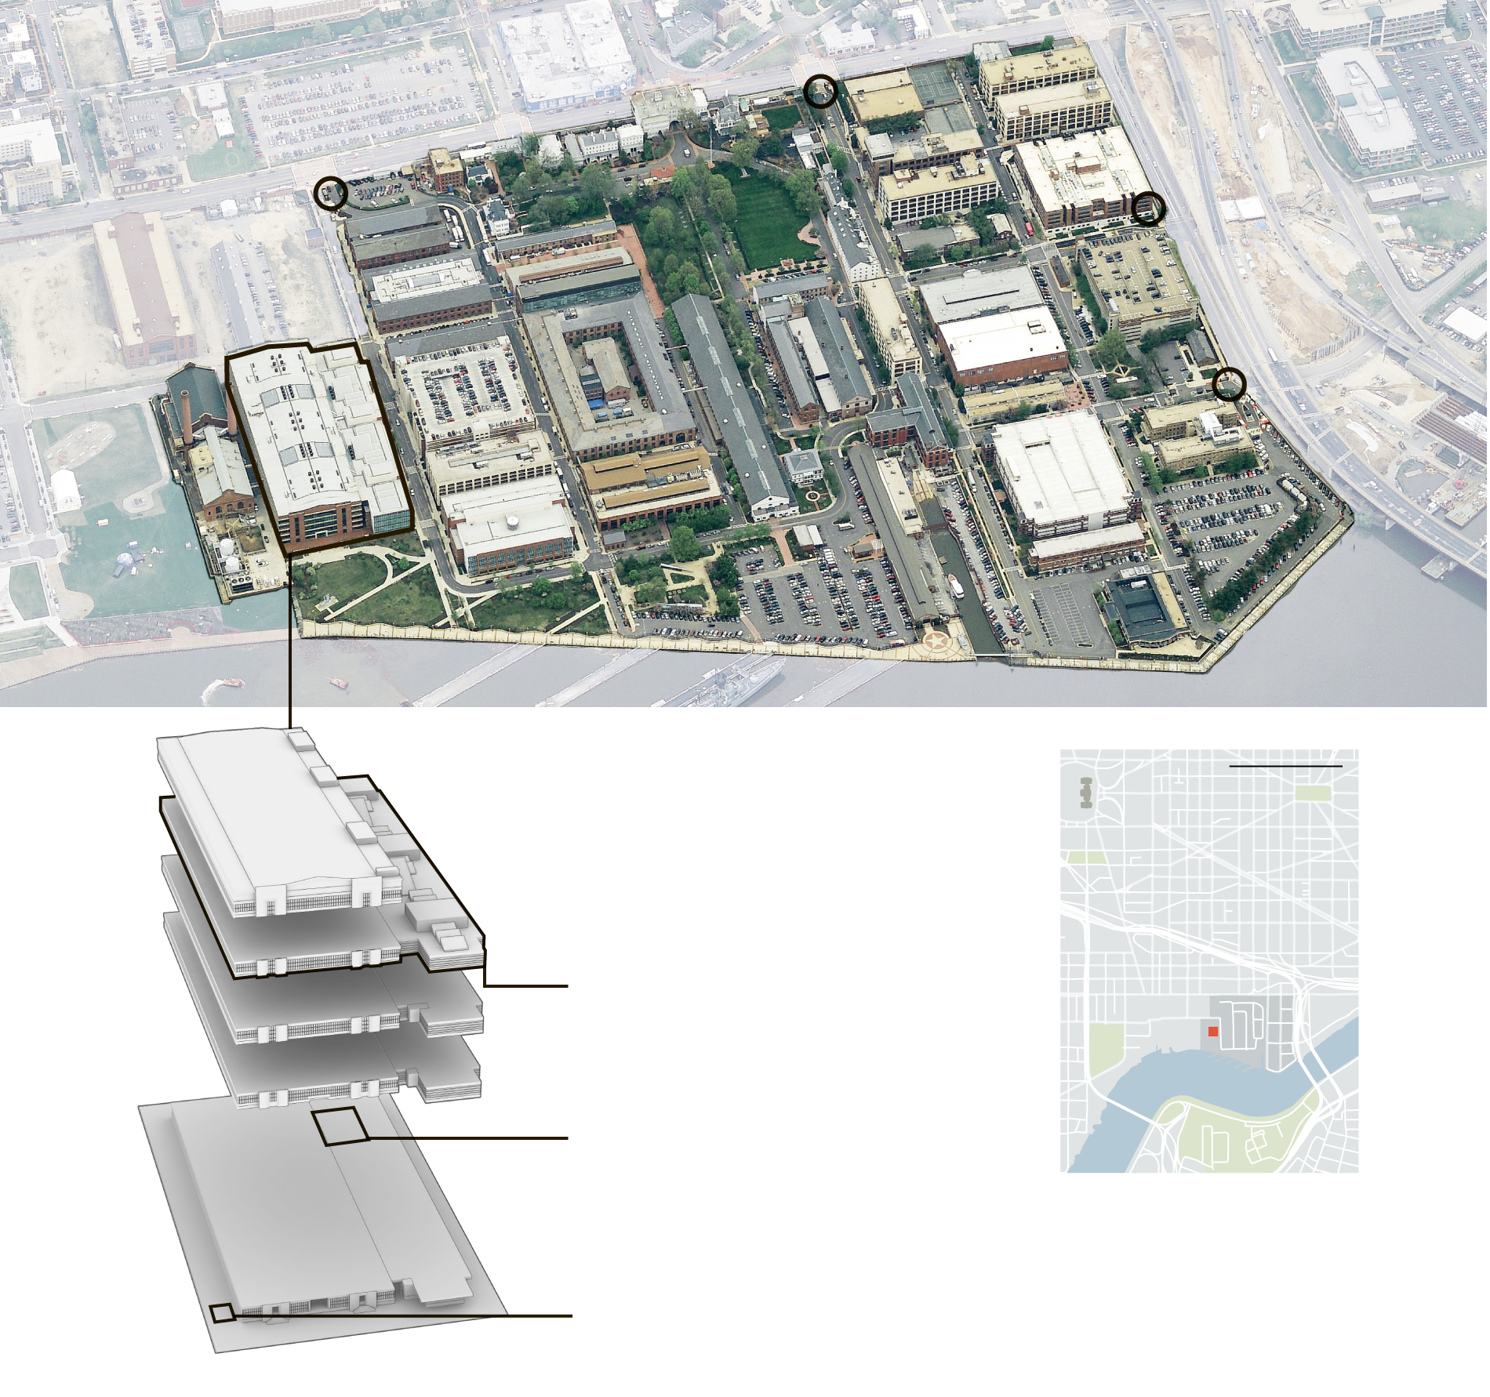
Notes:
Naval Sea Systems Command (NAVSEA)
NAVSEA is the largest tenant in the installation. Which over 3,000 of the WNY’s personnel are concentrated at NAVSEA’s headquarters
Colloquially known as building 197.
Overall, the building encompasses 638,000 square feet and five floors, with what responders on scene described as a dense “maze like” interior.
NAVSEA’s layout consists of various cubicles, training facilities, conference rooms and auditoriums with pathways that only allowed a few feet of clearance and long narrow hallways that stretch the entire the length of the building.
As depicted in Figure. 1., NAVSEA’s physical location is on the west side of the complex by Isaac Hull Avenue, directly south of the closest entrance off of the 6th Street Gate.

Slide 17
69 Minutes
*Approximately 70% of the active shooter incidents analyzed concluded in 5 minutes or less.
Notes:
In the course of the incident, Alexis fatally shoots 12 people and injures eight others (including four officers), 10 of the fatalities occurring within the first 6 minutes.

Slide 18
Clausewitz’ Fog of War
Notes:
Fog
Clausewitz uses the metaphor ‘Fog’ to describe “lack of complete, accurate situational awareness/information about unfolding events and conditions, and what is needed most/where”.
Friction
Clausewitz describes the concept of friction as obstacles or unexpected circumstances which impede on the effectiveness for response. Specifically, friction is attributed by “uncertainties, tech. or logistical difficulties, physical impediments, requiring additional effort and slowing down response and/or recovery verses ‘ideal’ implementation”.

Slide 19

Mobile Phone Policy
An additional factor in the communication gap included the mobile phone policy exhibited for building 197, which prohibited cell phone use.
Notes:
Sensitive Compartmented Information Facilities (SCIFs)
The policy is primarily in place in accordance to the SCIFs and the presence for classified information located in the building.
A common practice enforced among SCIF’s due to Physical and Technical Security Standards implemented in Executive Order 13526 under the Obama Administration.
By virtue of the policy, less victims had the ability to even alert officials that an emergency was occurring.
D.C. Office of Unified Communications (OUC)
The city’s OUC call center received 62 calls to 911 between 8:17 and 11:00 a.m.

Slide 20
OPNAVINST 3440.17
3
Navy Installation Emergency Management Program

Slide 21
PAPA 5354 Response and Recovery
Prevent
What you can
Protect
What you can’t prevent
Mitigate
What you can’r pprotect
Prepare
For what you can’t mitigate
Respond
To what occurs
Recover
From what you must
Notes:
Reflection question:
What does “Recovery” look like for Active Shooter Incidents?
Normalcy?
NAVSEA didn’t reopen until February 2nd, 2015

Slide 22
National Incident Management System (NIMS) Key Principles
Command and Control
Planning
Training and Exercises

Slide 23
Continued
Equipment
Public Information
Program Oversight

Slide 24
Those in the university community who may wish assistance or desire counseling support may contact:
Cook Counseling Center at 540-231-6557
Dean of Students Office at 540-231-3787
Office of Housing and Residence Life at 540-231-6205
Hokie Wellness at 540-231-2233 (students) or 540-231-8878 (employees)
Employee Assistance Program
  Anthem at 1-855-223-9277
  Aetna at 1-888-238-6232 (company name: Commonwealth of Virginia, username: COVA, password: COVA)
  Kaiser Permanente at 1-866-517-7042
Referrals to a campus cleric may be done through the Dean of Students Office at 540-231-3787.

Slide 25
Thank You for Your Time!
ANY QUESTIONS?
You can find me at
jslaugh@vt.edu

